Slide 1
Kaggle Two-Sigma Apartment Interest Project
Project Team: Emil Parikh, and Glen Ferguson, Jason Chen

Slide 2
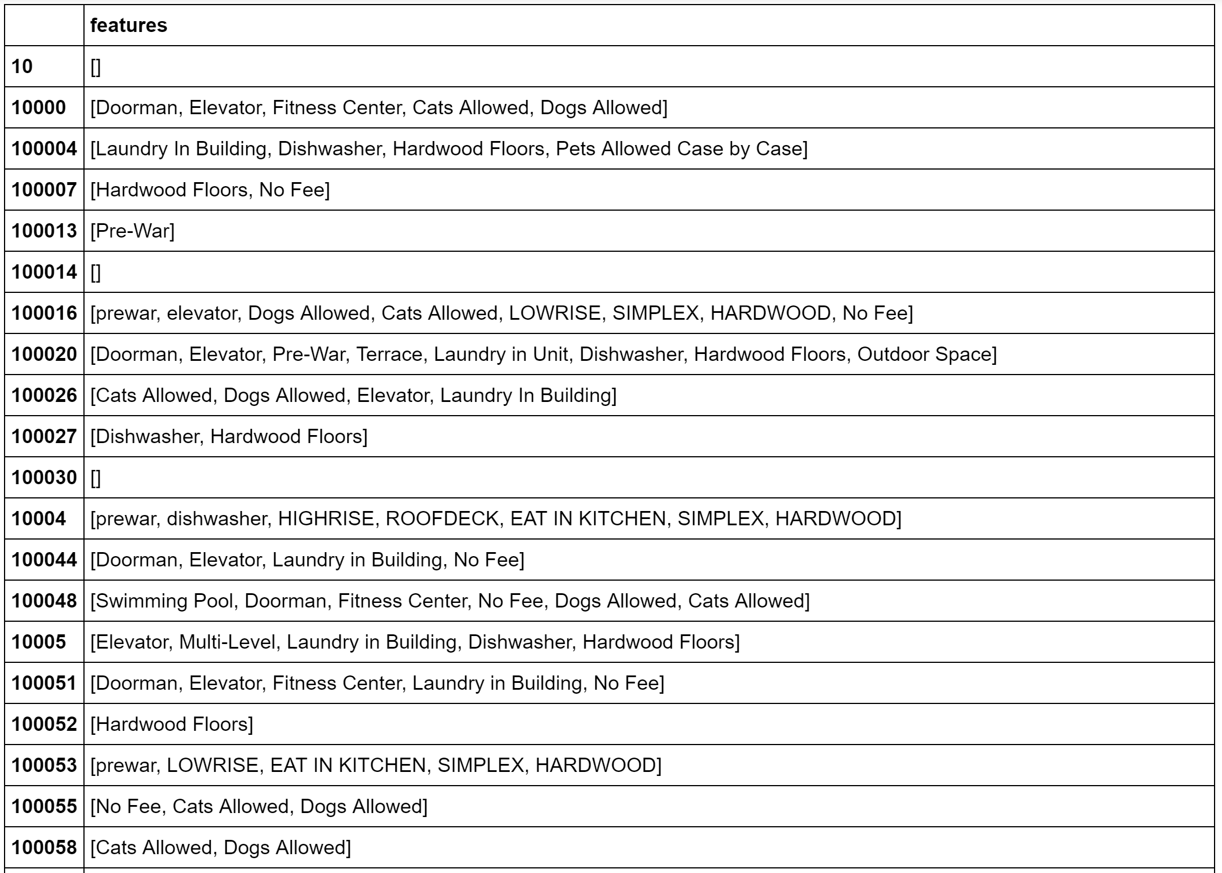
Features
List format
Many features with the same meaning
‘pre-war’ vs ‘pre war’
‘laundry’ vs ‘dryer/washer’

Slide 3
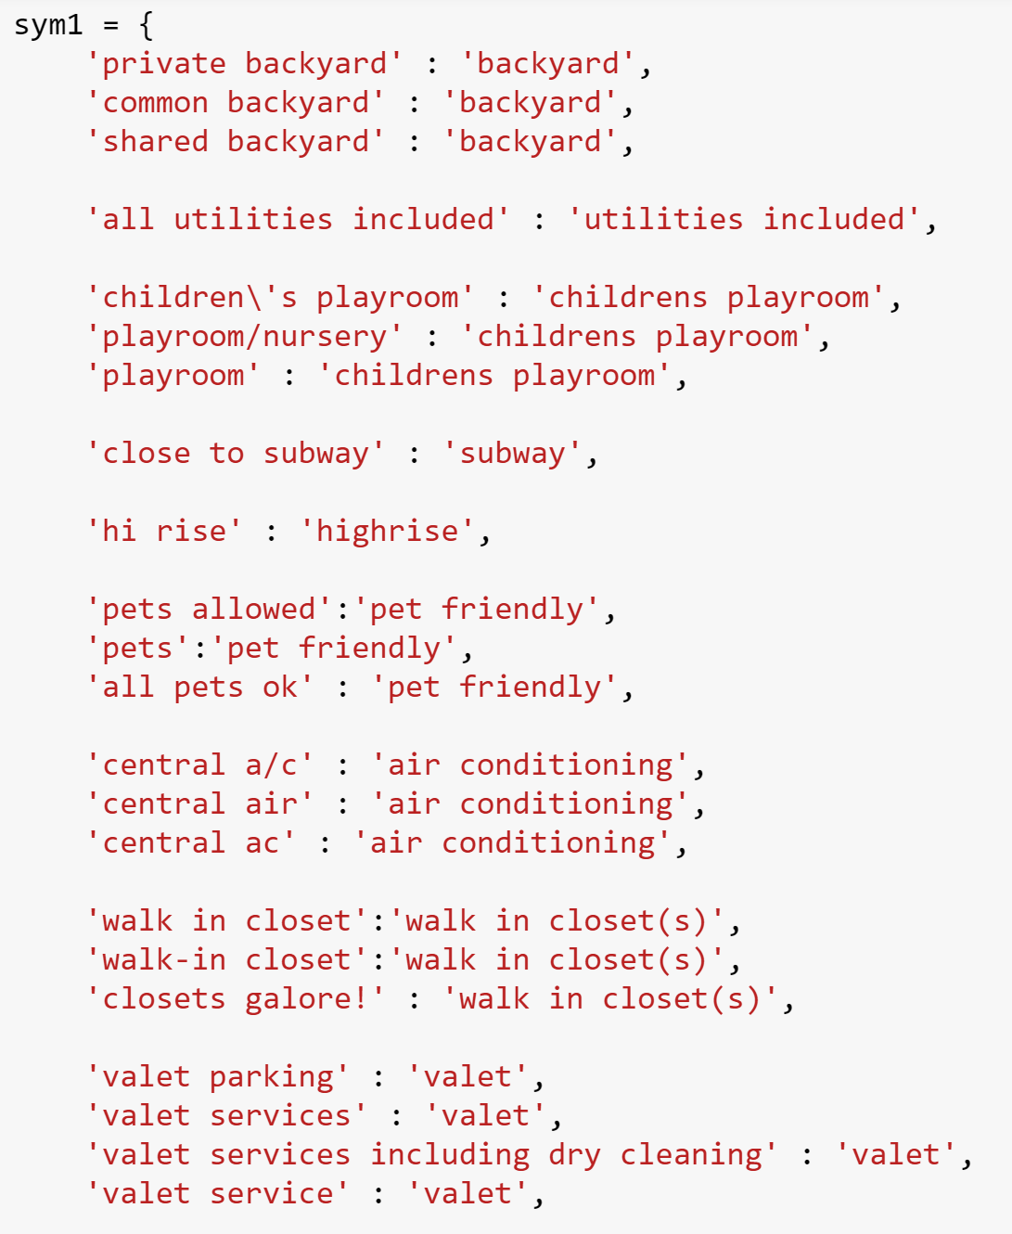
Features
Standardize feature names
Count vectorized with tfidf
Created 400 columns
Too many columns for grid searching RF
How did we reduce dimensionality?

Slide 4
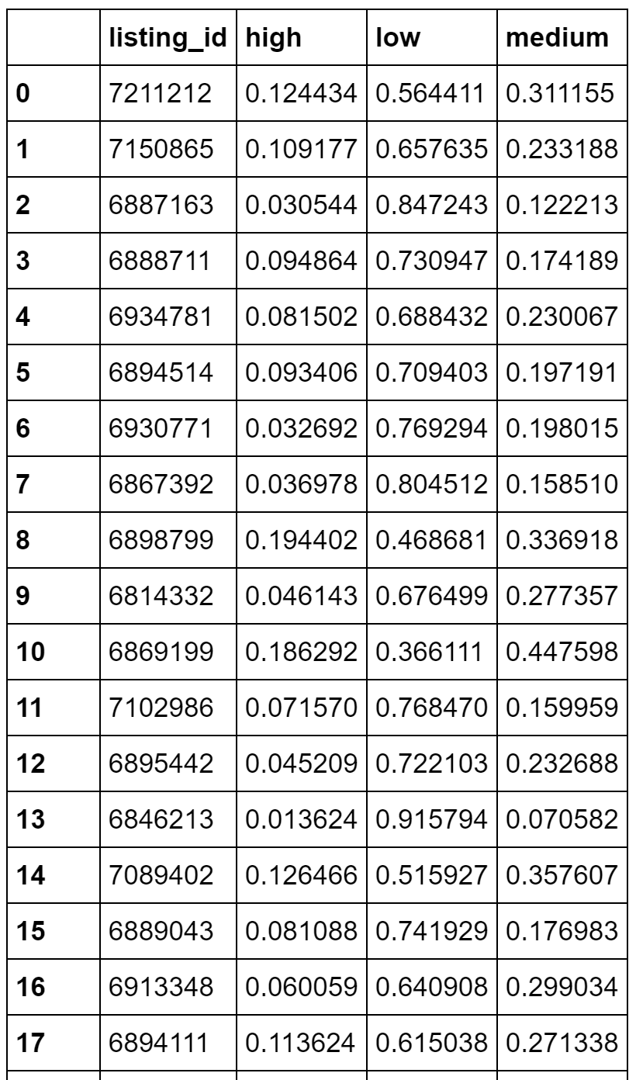
Features
Performed a logistic regression using only the 400 columns of features
Used the predictions as new predictors for base model

Slide 5
XGBoost
Made decent predictions out of the box (relative to other models)
Lots of tuning parameters
Not very feasible to do a full grid search under a time constraint
Difficult to tune

Slide 6
Accuracy

Slide 7
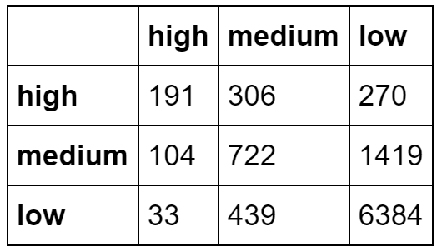
XGB Base Model

Slide 8
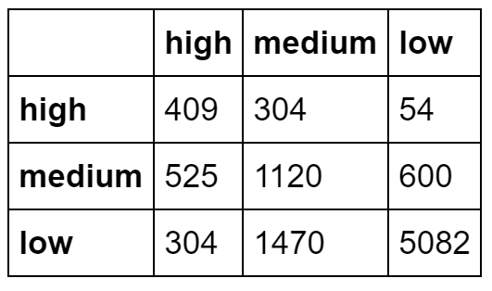
Upsampled XGB

Slide 9
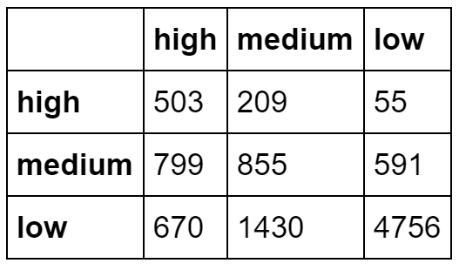
Upsampled XGB

